Slide 1
JJS Tuition Centre
By: Surya, Jason, Brennen And William

Slide 2
Our Company Background
Our company JJS Tuition Centre Was Founded On 1st January 2020. What does the “JJS” stands for? It is based on the first founding father, JoJo and combined with the word “School”. Hence, JJS, JoJo’s School.
What Inspired Our Founding? Every year, many secondary school students do not get their desired results. However, we believed that all students have their own potential to excel. Hence, we founded JJS Tuition Centre to get to the students that are struggling and bring out their potential.

Slide 3
Our Company
Background
Staff We have over 8 teachers
Location 180 Ang Mo Kio Avenue 8. Singapore 569830 -Note: we had to use NYP address for our map plugin to work as a fake address will not work.

Slide 4
Our Company's Purpose
Here at JJS Tuition Centre, we strive to bring the best tuition experience and school results to our students.
We ensure that your child will be taught in a fun and conducive environment.
To ensure that students of JJS Tuition Centre will achieve their desired results for their N and O’s.

Slide 5
Services provided
We teach secondary school subjects such as:
English
Social Studies
History
Geography
Mathematics
Mother Tongue
Physics
Chemistry
Biology
Literature
D&T
F&N
POA

Slide 6
Why does the company need a website?
To compete with existing tuition centres such as “The Learning Lab” and “AspireHub”.
To grow its customer base
Allow people to search for more details about JJS Tuition Centre at their own convenience

Slide 7
Task Allocation
Jason: home.html, privacy.html, and template
Brennan: programmes.html, teachersect.html
Surya: aboutus.html, testimonial.html, tc.html(terms & conditions), enrol.html, enrolreceive.html
William: contactus.html, FAQ.html, contactreceive.html

Slide 8
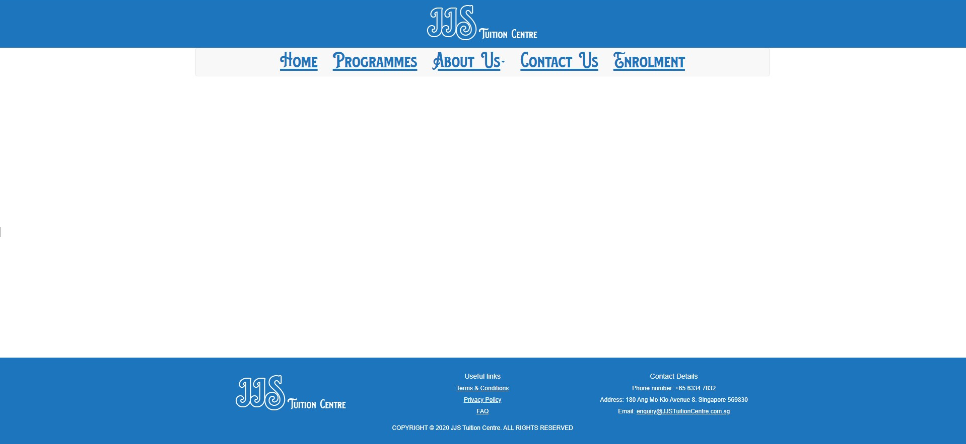
Our UI Design -easy navigation/user experience
Needed it to be easy to navigate
Inspired by existing tuition centres’ websites
Needed it to be responsive throughout all devices
Symmetrical layout in general
Ensured we had design consistency across all webpages
Identical colour scheme
Preview of our template:
Notes:
Design Consistency example: Text Size, Bootstrap 3, Colour Scheme

Slide 9
Let’s look at our web pages!

Slide 10
Challenges Faced
Template Navigation bar did not collapse at first Constantly updating templates Coming up with design for the footer
Home Lack of resources available
Programmes Lack of content - Too much time wasted on coming up of content
About Us/Company Information Trying to make the map plugin work Trying to fill up the space on my webpage
Contact Us Map Responsiveness and overall design did not work together. Did not communicate with the group - changes of code
and more...

Slide 11
References
CSS & HTML: https://www.w3schools.com/
Bootstrap 3: https://stackoverflow.com/ https://www.w3schools.com/ Navigation bar: https://www.youtube.com/watch?v=qpWlaOeGZ_4
Java Script: https://www.w3schools.com/ https://stackoverflow.com/

Slide 12
Citations
Images of the teachers: https://colorlib.com/wp/portfolio-tag/online-courses/ Content for privacy.html & tc.html: https://www.mavistutorial.com/
Layouts Inspiration https://www.thelearninglab.com.sg/ https://aspirehub.com/ https://www.w3schools.com/

Slide 13
Q & A

Slide 14
Thank You!

